Slide 1
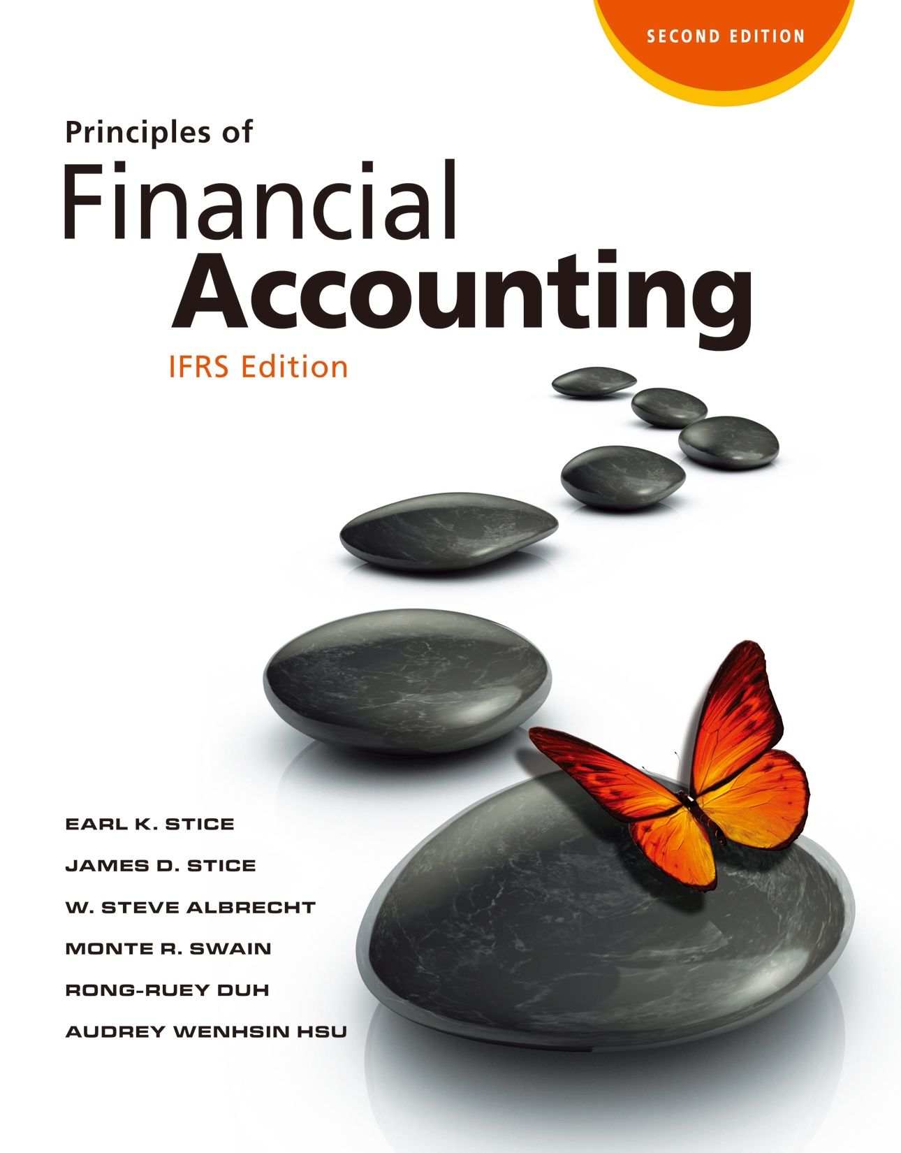

Slide 2
Financing: Equity

Slide 3
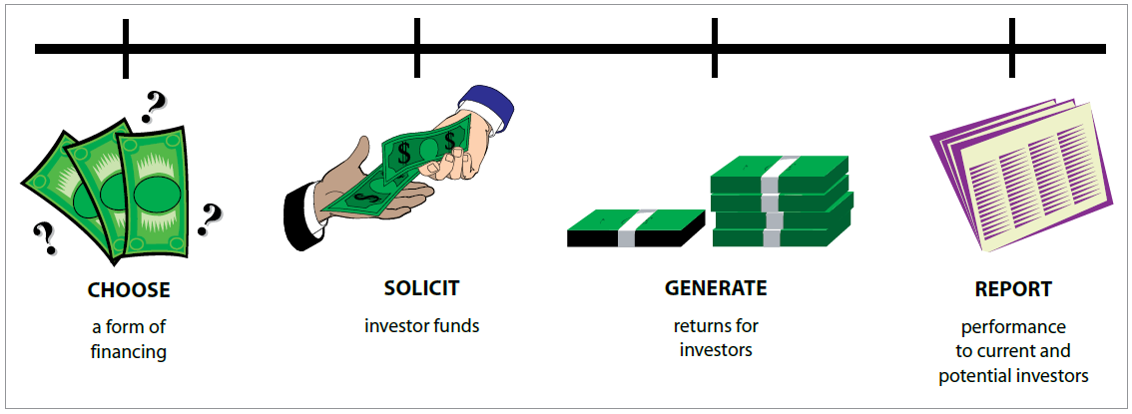
Raising Equity Financing
Raising Equity Financing
LO1
Timeline of Business Issues Involved with Investor Financing
Exhibit 11.4

Slide 4
Raising Equity Financing
LO1
Difference between a Loan and an Investment
Loan | Investment
Company is obligated to repay the principal amount, even during bad times. | Company is not obligated to repay the principal amount (investors can lose all of their investment).
Lender does not share in the success of the company. | Investor shares in the success of the company.

Slide 5
Proprietorships and Partnerships
LO1
Proprietorship
A business owned by one person.
Partnership
An association of two or more individuals or organizations to carry on economic activity.
Characteristics
Ease of formation
Limited life
Unlimited liability

Slide 6
Corporations
Corporations and Corporate Stock
LO2
A legal entity chartered by a state (in the case of U.S. corporation).
Ownership is represented by transferable shares of stock.
Characteristics
Limited liability.
Easy transferability of ownership.
Ability to raise large amounts of capital.
Double taxation.
Close government regulation.

Slide 7
Starting a Corporation
LO2
Prospectus
A report provided to potential investors that represents a company’s financial statements and explains its business plan, sources of financing, and significant risks.
Stockholders (Shareholders)
Individuals or organizations that own a portion (shares of stock) of a corporation.
Board of Directors
Individuals elected by the stockholders to govern a corporation.

Slide 8
Common Stock
LO2
Rights of the Common Stockholder
Voting rights.
Preemptive right.
Dividend rights.
Corporate asset rights.

Slide 9
Preferred Stock
LO2
Rights of the Preferred Stockholder
Usually no voting rights.
Limited to a fixed cash dividend.
In the event the corporation is liquidated, preferred stockholders are entitled to have their claims repaid fully before any cash is paid to common stockholders.
Many times includes a conversion option.

Slide 10
Issuance of Stock
Accounting for Stock
LO3
Par Value
A nominal value assigned to and printed on the face of each share of a corporation’s stock.
When par-value stock sells for a price above par, it is said to sell at a premium.

Slide 11
Issuing Par-Value Common Stock at a Premium
LO3
Illustration
Assume that the UBM Company issued 1,000 shares of $1 par-value common stock for $50 per share.
The entry to record the stock issuance is:
Cash (1,000 shares ⨉ $50)
50,000
Common Stock (1,000 shares ⨉ $1 par value)
1,000
Paid-in Capital in Excess of Par, Common Stock
(1,000 shares ⨉ $49)
49,000
Issued 1,000 shares of $1 par-value common stock at $50 per share.

Slide 12
Issuing Par-Value Common Stock at a Premium
LO3
Contributed Capital
The total par value of the common and preferred stock, along with the associated amounts of paid-in capital in excess of par, constitutes a corporation’s contributed capital.

Slide 13
Issuing No Par-Value Shares
LO3
Illustration
Assume that the UBM stock does not have a par value and that the corporation issued 1,000 shares for $50 per share.
The entry to record this stock issuance would be:
Cash
50,000
Common Stock
50,000
Issued 1,000 shares of no-par stock at $50 per share.

Slide 14
Issuing Par-Value Preferred Stock at a Premium
LO3
Illustration
UBM issued 1,000 shares of $40 par value preferred stock for cash at $45 per share.
Cash
45,000
Preferred Stock
40,000
Paid-in Capital in Excess of Par, Preferred Stock
5,000
Issued 1,000 shares of $40 par-value preferred stock at $45 per share.

Slide 15
Issuing Shares for Noncash Assets
LO3
The assets or services received should be recorded at the current market value of the stock issued.
If the market value of the stock cannot be determined, the market value of the assets or services received should be used as the basis for recording the transaction.

Slide 16
Issuance of Stocks for Non-Cash Assets
LO3
Illustration
Assume that a prospective stockholder exchanged a piece of land for 5,000 shares of the UBM $1 par-value common stock.
Assuming the market value of the stock at the date of the exchange was $40 per share, the entry is:
Land (5,000 shares ⨉ $40)
200,000
Common Stock (5,000 shares ⨉ $1)
5,000
Paid-in Capital in Excess of Par, Common Stock
(5,000 shares ⨉ $39)
195,000
Issued 5,000 shares of $1 par-value common stock for land
(5,000 shares x $40 per share = $200,000).

Slide 17
Accounting for Stock Repurchases
LO3
Reasons for a Firm to Buy Back Outstanding Stocks
Wants the stock for a profit-sharing, bonus, or stock-option plan for employees.
Feels that the stock is selling for an unusually low price and is a good buy.
Wants to stimulate trading in the company’s stock.
Wants to remove some shares from the market in order to avoid a hostile takeover.
Wants to increase reported earnings per share by reducing the number of shares of stock outstanding.

Slide 18
Purchasing Treasury Stock
LO3
Illustration
Assume that 100 shares of the $1 par-value common stock were reacquired by UBM $60 per share.
The entry to record the repurchase is:
A contra-equity account.
Treasury Stock, Common
6,000
Cash (100 shares ⨉ $60)
6,000
Purchased 100 shares of treasury stock at $60 per share.

Slide 19
Reissuing Treasury Stock above Cost
LO3
Illustration
Assume that 40 of the 100 shares of the treasury stock that were originally purchased for $60 per share are reissued at $80 per share.
The entry to record that reissuance is:
Cash (40 shares ⨉ $80)
3,200
Treasury Stock, Common (40 shares ⨉ $60 cost)
2,400
Paid-in Capital, Treasury Stock [40 ⨉ ($80 – $60)]
800
Reissued 40 shares of treasury stock at $80 per share.
Don’t recognize as gain!

Slide 20
Reissuing Treasury Stock below Cost
LO3
Illustration
Assume that another 30 shares of treasury stock are reissued for $40 per share, $20 less than their cost.
Because Paid-In Capital, Treasury Stock has a balance of $800, the entry to record this transaction is:
Cash (30 shares ⨉ $40)
1,200
Paid-in Capital, Treasury Stock
600
Treasury Stock, Common (30 shares ⨉ $60 cost)
1,800
Reissued 30 shares of treasury stock at $40 per share; original cost was $60 per share.

Slide 21
Reissuing Treasury Stock below Cost
LO3
Illustration
Next, assume that the company reissues 20 additional shares at $45 per share.
The entry to record this transaction is:
Cash (20 shares ⨉ $45)
900
Paid-in Capital, Treasury Stock
200
Retained Earnings
100
Treasury Stock, Common (20 shares ⨉ $60 cost)
1,200
Reissued 20 shares of treasury stock at $45 per share; original cost was $60 per share.
Because the Paid-in Capital, Treasury Stock account had a balance of only $200.

Slide 22
Balance Sheet Presentation
LO3
The following data, with the addition of the preferred stock information in (1), summarizes the stock transactions of the UBM shown earlier:
$40 par-value preferred stock: | issued 1,000 shares at $45 per share.
$1 par-value common stock: | issued 1,000 shares at $50 per share.
$1 par-value common stock: | issued 5,000 shares for land with a fair market value of $200,000.
Treasury stock, common: | purchased 100 shares at $60; reissued 40 shares at $80; reissued 30 shares at $40; reissued 20 shares at $45.

Slide 23
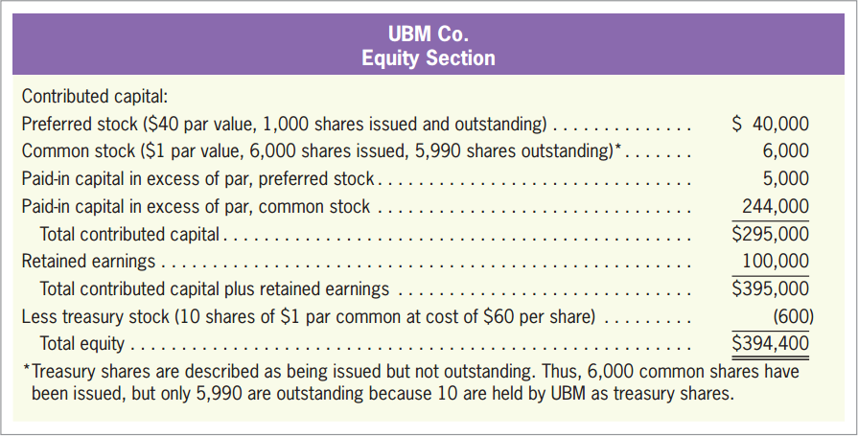
Balance Sheet Presentation
LO3
With these data, and assuming a Retained Earnings balance of $100,000, the equity section would be:
Exhibit 11.6

Slide 24
Quiz Yourself
LO3
Hufnagel Company issued 10,000 shares of €1 par-value common stock for €12 per share. Hufnagel subsequently repurchased 400 shares of this common stock when the market price of those shares was €17 per share.

Slide 25
Quiz Yourself
LO3
Make the journal entry to record the initial sale of the stock.
Make the journal entry to record the subsequent repurchase of the 400 shares of stock.
Cash
120,000
Common Stock (10,000 shares ⨉ €1 par value)
10,000
Paid-in Capital in Excess of Par, Common Stock
110,000
Treasury Stock, Common
6,800
Cash (400 shares ⨉ €17)
6,800

Slide 26
Retained Earnings
Retained Earnings
LO4
The portion of a corporation’s owners’ equity that has been earned from profitable operations and not distributed to stockholders since incorporation.
NOT cash!
Increased by net income.
Decreased by dividends, net losses, and some treasury stock transactions.

Slide 27
Types of Dividend
LO4
Cash Dividend
Stock Dividend
Property Dividend

Slide 28
Accounting for Cash Dividends
LO4
Declaration Date
The date on which a corporation’s board of directors formally decides to pay a dividend to stockholders.
Assume that the board of directors votes on December 15, 2018, to declare an $8,000 dividend, this liability is recorded as follows:
Dividends
8,000
Dividends Payable
8,000
Declared dividend on December 15, 2018.

Slide 29
Accounting for Cash Dividends
LO4
Closing Entry
At the end of the year, the dividends account is closed to Retained Earnings by the following entry:
Retained Earnings
8,000
Dividends
8,000
To close Dividends to Retained Earnings.

Slide 30
Accounting for Cash Dividends
LO4
Date of Record
The date selected by a corporation’s board of directors on which the stockholders of record are identified as those who will receive dividends.
No journal entry is required on the date of record.
The date of record is simply noted in the minutes of the directors’ meeting and in a letter to stockholders.

Slide 31
Accounting for Cash Dividends
LO4
Payment Date
The date on which a corporation pays dividends to its stockholders.
The entry to record a dividend payment would typically be:
Dividends Payable
8,000
Cash
8,000
Paid dividends declared on December 15, 2018.

Slide 32
Dividend Preferences
LO4
Current-Dividend Preference
The right of preferred stockholders to receive current dividends before common stockholders receive dividends.
Cumulative-Dividend Preference
Dividends in Arrears

Slide 33
Dividend Preferences
LO4
Illustration
The outstanding stock of UBM includes:
4 Cases for dividends preferences
$40 × 5% × 1,000 shares = $2,000
Preferred stock | 5%, $40 par value, 1,000 shares issued and outstanding.
Common stock | $1 par value, 6,000 shares issued, 5,990 shares outstanding.
Exhibit 11.7

Slide 34
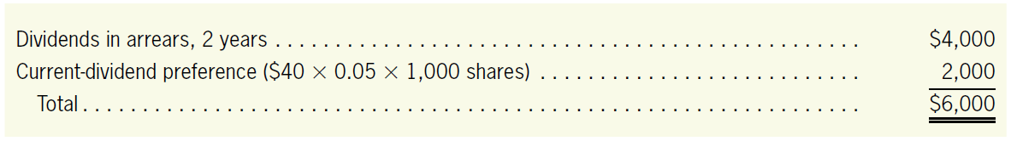
Dividend Preferences
LO4
Illustration
In case 3 and case 4, UBM has not paid any dividends for the last two years but has declared a dividend in the current year.
UBM must pay $6,000 in dividends to preferred stockholders before it can give anything to the common stockholders. The calculation is as follows:

Slide 35
Cumulative-Dividend Preference
LO4
Illustration
The entries to record the declaration and payment of dividends in Case 4 are:
Date of Declaration
Dividends, Preferred Stock
6,000
Dividends, Common Stock
5,000
Dividends Payable
11,000
Declared dividends on preferred and common stock.
Date of Payment
Dividends Payable
11,000
Cash
11,000
Paid dividends on preferred and common stock.

Slide 36
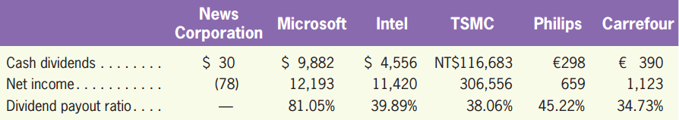
Dividend Payout Ratio
LO4
The percentage of earnings paid out in dividends.
Cash Dividends
Net Income
Dividend payout ratio =

Slide 37
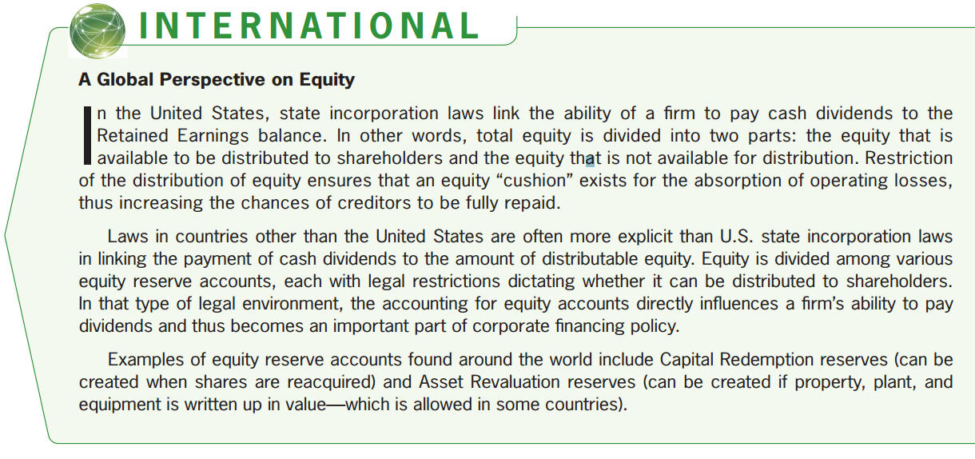
Constraints on Payment of Cash Dividends
LO4

Slide 38
Stock Dividends
LO4
A form of dividends that requires a company to issue new shares to its shareholders without receiving cash.
Small stock dividends: assigning the fair value.
Large stock dividends: assigning the par value.
The line between small and large stock dividends is often set at 20-25% of the company’s issued shares.

Slide 39
Stock Dividends
LO4
Illustration—Small Stock Dividends
Taking Hess Inc. as an example, suppose that its common stock has a par value of €1, and market value of €2.5 per share.
In the case of declaring 15% stock dividends (7,500 new shares), the journal entry is as follows:
Stock Dividends (€2.5 ⨉ 7,500)
18,750
Stock Dividends Distributable (€1 ⨉ 7,500)
7,500
Paid-in Capital in Excess of Par (€1.5 ⨉ 7,500)
11,250
Declaration of 15% stock dividends.

Slide 40
Stock Dividends
LO4
Illustration—Small Stock Dividends
The account Stock Dividends will be closed to Retailed Earnings, as shown below.
When Hess issues the dividend shares, the journal entry is as below.
Retained Earnings
18,750
Stock Dividends
18,750
Stock Dividends Distributable
7,500
Common Stock
7,500
Issuing 7,500 dividend shares.

Slide 41
Stock Dividends
LO4
Illustration—Small Stock Dividends
A before-and-after comparison is shown below.

Slide 42
Stock Dividends
LO4
Illustration
Assume that Hess declares a 30% stock dividend, it would issue 15,000 (50,000 ⨉ 30%) new shares. The journal entry is as follows:
Assigning the par value.
Stock Dividends (€1 ⨉ 1,500)
15,000
Stock Dividends Distributable
15,000
Declaration of a 30% stock dividends.

Slide 43
Stock Split
LO4
Results in increases of the number of shares outstanding in the same proportion that par or stated value per share decreases.
A 2-for-1 stock split.
Par value: €10 → €5
Number of shares outstanding : 100,000 shares → 200,000 shares

Slide 44
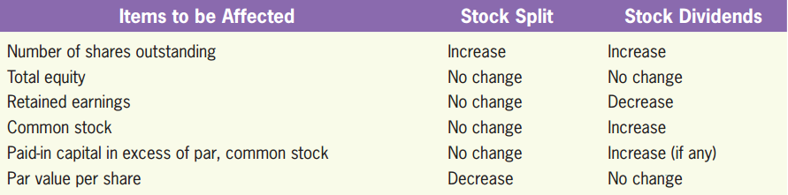
Stock Split vs. Stock Dividends
LO4

Slide 45
Quiz Yourself
LO4
Essman Company, which has 5,000 shares of 5% preferred stock with a $10 par value, and 20,000 shares of $10 par value common stock, declares a $20,000 cash dividend to be paid three months from the date of declaration.

Slide 46
Quiz Yourself
LO4
Record the transactions on the date of declaration and the date of payment.
Cash dividends for preferred stock = 5% ⨉ $10 ⨉ 5,000 shares = $2,500
Cash dividends for common stock = $20,000 – $2,500 = $17,500
On the date of cash dividend declaration:
Dividends, Preferred Stock (or Retained Earnings)
2,500
Dividends, Common Stock (or Retained Earnings)
17,500
Dividends Payable
20,000
On the date of cash dividend payment:
Dividends Payable
20,000
Cash
20,000

Slide 47
Quiz Yourself
LO4
Independent of the above transactions, suppose that Essman declares 10% stock dividends to common stockholders. The market price is $12 per share. Record the transactions on the date of declaration and the date of payment.
Stock dividends for common stock = 10% ⨉ 20,000 shares = 2,000 shares
On the date of stock dividend declaration:
Stock Dividends ($12 × 2,000)
24,000
Stock Dividends Distributable ($10 × 2,000)
20,000
Paid-in Capital in Excess of Par, Common Stock
4,000
On the date of stock dividend payment:
Stock Dividends Distributable
20,000
Common Stock
20,000

Slide 48
Other Comprehensive Income
Other Equity Items
LO5
Two Common Other Comprehensive Income Items
Foreign currency translation adjustment
Unrealized gains and losses on available-for-sale financial assets

Slide 49
Other Comprehensive Income
LO5
Other Comprehensive Income vs. Accumulated Other Comprehensive Income
Other comprehensive income: reported on the statement of comprehensive income, which is a portion below net income.
Accumulated other comprehensive income: an cumulative account of other comprehensive income and is reported on the balance sheet.

Slide 50
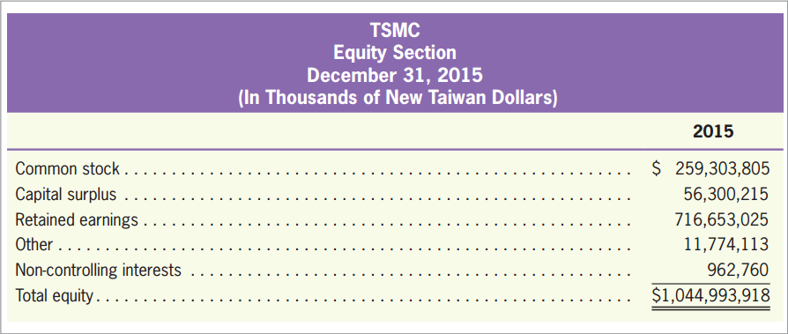
Other Comprehensive Income
LO5
Equity Section for TSMC
Accumulated other comprehensive income is also called “other equity“ or “other reserves”.
Exhibit 11.8

Slide 51
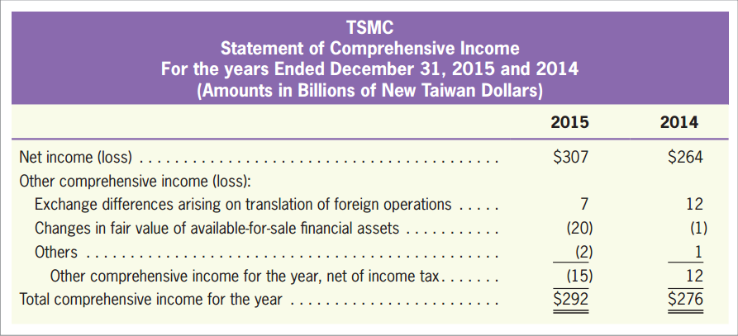
Other Comprehensive Income
LO5
Statement of Comprehensive Income for TSMC
Exhibit 11.9

Slide 52
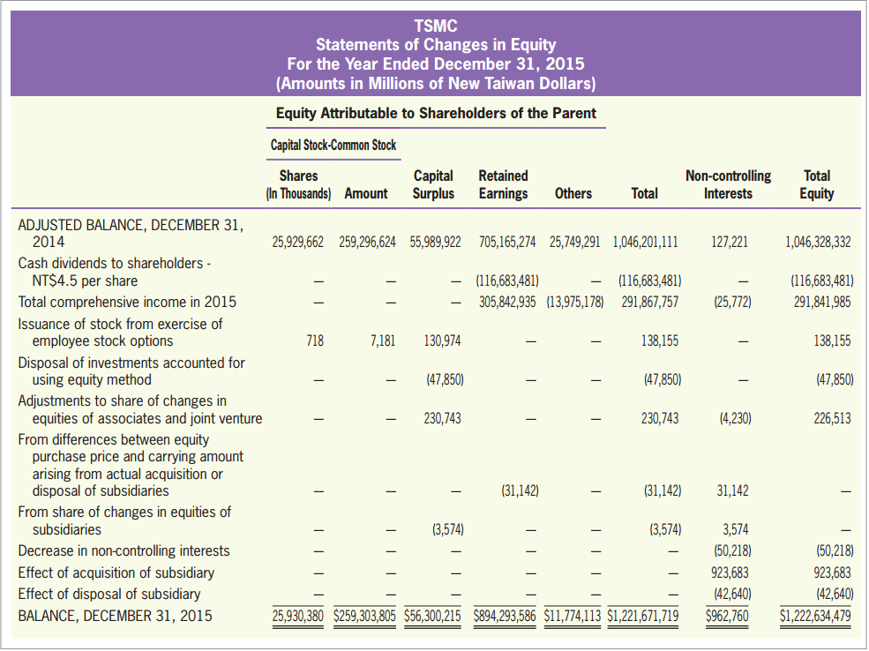
Statement of Changes in Equity
LO5
Statement of Changes in Equity for TSMC
Exhibit 11.10

